Slide 1


Webinar: Diving into Zero Trust and Building Secure 5G Networks

Slide 2

Meet our Speaker
Suresh Galam
Director – R&D Engineering and Technologies
Suresh has 20 Years of experience in the Networking & Telecom domain as a Consultant and Architect. He has worked with many Telecom service providers and network vendors across the globe, such as Cisco, Juniper, Ericsson, Microsoft, Intel, Verizon, T-Mobile, and Comcast. He holds an executive MBA from IIM-Lucknow and has cleared all primary technical certifications from Cisco and Juniper. He is also passionate about Networking, SDN/NFV, SDWAN, 5G, Cloud, and Open-source technologies, and he is currently working at ACL Digital as Director of R&D Engineering Services.

Slide 3

Agenda
1
Zero Trust Principles in 5G
2
Role of Service Mesh in 5G Core
3
Building 5G Security with Intel SGX
4
Future Steps for Building Zero Trust 5G

Slide 4
Zero Trust
1
Zero Trust isn’t a checklist, and it’s not a product. It sounds easy enough, but it isn’t quite simple.
2
Zero Trust is a strategic mindset based on the principle “never trust, always verify,” which means wherever the request comes from or what resources are being accessed, we need to ‘verify first’ before access is granted to the network.
3
Zero Trust model proposes to use new tools, practices and different way of thinking to overcome the traditional security architecture that assumes trust for devices/users.
4
Zero Trust is a new prototype where the implementation relies on several supporting technologies and processes, which include: IAM, MFA, NS, and SIEM systems and user awareness.
5
Organizations must adopt Zero Trust, which requires cultural change at all levels. All the stakeholders across the organization must work together to achieve it.

Slide 5
Zero Trust Principles in 5G
1
Applying Zero Trust to 5G infrastructure makes the organization successfully operate the 5G networks easier, faster and safer.
2
By adopting Zero-Trust principles for 5G security, organizations can improve security from multiple angles, which include Continuous Validation, Network Segmentation, Security Policies, Identity Validation, and Least Privilege.
3
Securing 5G requires a Zero-Trust approach to protect all elements of the mobile network across cloud workloads, key network interfaces, and user traffic, where the users and their devices are continuously monitored and validated during their session.
4
As 5G adoption accelerates, zero trust principles can be spread through the entire 5G architecture end-to-end including RAN, Transport and Core – and consists of multiple layers.
5
To achieve a Zero Trust Architecture for 5G deployments in the cloud, organizations should adopt a step-wise approach to proactively safeguard network functions, interfaces, and data against external and internal threats.

Slide 6
Role of Service Mesh in 5G Core
1
The Zero Trust Security model gives us the tools to automatically secure our services and their communication between 5G networks using service mesh.
2
Complementary technologies, such as Zero Trust and Service Mesh, work hand in hand and are well-suited for containerized environments like 5G, enabling the faster and more secure deployment of applications.
3
Few Service Meshes enable support for 5G workloads(CNF) along with existing 4G workloads (VNF) with network elasticity, granular traffic management, security, and access policies to traffic in/out and between Kubernetes clusters..
4
Service Meshes support Mutual Transport Layer Security (mTLS) to assign the identifier that provides identity and encryption to every request your services make on 5G SBA.
5
We need to choose service mesh which is powerful enough that can be used to easily and transparently enable a zero trust architecture to satisfy security and compliance requirements for 5G networks.

Slide 7
ACL Digital/Intel/Casa System joint PoC
ACL Digital, a system integrator partner of Intel, worked on a joint PoC to provide a secure cloud-native infrastructure solution leveraging Intel SGX features for confidential computing in telecom applications.
The solution consists of tools, including a Key Management Reference Application, a Secure Service Mesh, Trusted Attestation Services on top of the Red Hat Open shift Platform and container bare-metal reference platform.
1
2
These tools secure critical 5G Core and Edge and other telecom applications running on the network cloud with hardware-based security.
ACL Digital also participated in demos at MWC Las Vegas and India Mobile Congress, New Delhi, in 2022.
3
4
Reference: https://networkbuilders.intel.com/blog/secure-the-future-of-5g-networks-with-zero-trust-for-cloud-native-architectures

Slide 8
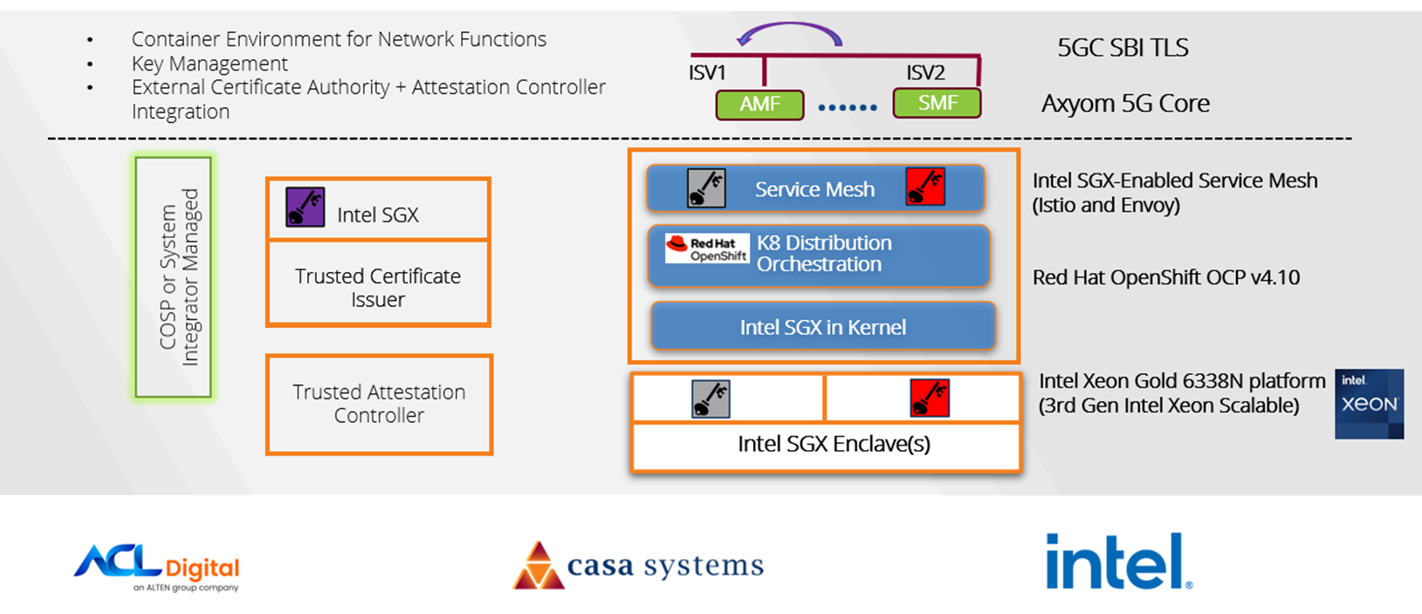


HSM based Zero Trust Service Mesh Communication
Secure 5G Core signaling made easy
At no time
private keys and secrets
will be unsecured.
Notes:
8

Slide 9
Building 5G Security with Intel SGX
A typical secured mTLS architecture across core, edge, and far edge
5G Core signaling made secured with Intel SGX
At no time private keys & secrets will be unsecured
Secured 5G Core signaling made easy with Intel KMRA
Few weeks of work with interoperability proven!
Proven by ACL Digital, using Intel KMRA and Casa 5GC NFs as is
Minimal performance impact measured on Intel Xeon SP
<5% throughput, 4% average latency, acceleration options
Adopted by leading key management solution providers
Notes:
9

Slide 10
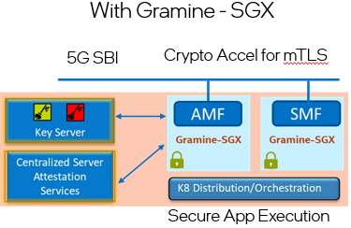
Future Steps - Securing application using Gramine-SGX
There is a strong desire to shield the whole application from the rest of the infrastructure for untrusted cloud and edge deployments.
Gramine supports this “lift and shift” paradigm for bringing unmodified applications into Confidential Computing with Intel SGX. Gramine can protect applications from a malicious system stack with minimal porting effort.
We at ACL Digital are exploring Gramine for different networking applications and the GSC tool (Gramine Shielded Containers) for directly converting existing microservice images to run with Gramine.
Key Benefits
Smallest attack surface, Hardware based security
Horizontally or vertically managed security for 5G Core
Hardware crypto-acceleration for mTLS and IPSec
Notes:
10

Slide 11


Questions?

Slide 12






Thank you
For more details, contact:
Tel: +1 (408) 755 3000
Email: business@acldigital.com
Website: www.acldigital.com
Copyright Information
This document contains information that is proprietary to ACL Digital. The Receiver shall not reverse, engineer, disassemble or decompile the above prototypes, know-how, formulae, processes, algorithms, ideas, strategies, inventions, data, network configurations, system architecture, designs, flow charts, drawings without the written permission from the Maker (ACL Digital). All company names, brand names, trademarks and logos mentioned in this document are the property of their respective owners.

